Slide 1
Jet Journey
Name : Dhananjay Manik Bhagat
SPPU Exam Seat No : 3384
Division : C

Slide 2
EXISTING SYSTEM
Manual Processes: Relies on manual procedures for vehicle reservations, involving paperwork and in-person interactions.
Limited Accessibility: Customers face challenges accessing real-time information about vehicle availability, pricing, and specifications.
Inefficient Fleet Management: Fleet management is conducted manually, including tracking vehicle usage, maintenance schedules, and overall fleet performance.
Security Gaps: Absence of a robust user authentication system raises security concerns, potentially compromising user data and access controls.

Slide 3
NEED FOR SYSTEM
Automation for Efficiency: Implement automation to streamline and optimize the vehicle rental process, reducing manual effort and enhancing overall efficiency.
Enhanced Customer Accessibility: Develop a digital platform that allows customers easy access to real-time information about vehicle availability, pricing, and specifications.
Prevention of Overbooking: Introduce a system with real-time updates to minimize the risk of overbooking, ensuring a more reliable and customer-friendly service.
Efficient Fleet Management: Provide administrators with tools for efficiently managing the vehicle fleet, including monitoring usage, scheduling maintenance, and optimizing overall fleet performance.
Improved Customer Experience: Enhance the overall customer experience by offering a user-friendly, convenient, and reliable platform for renting vehicles.

Slide 4
PROPOSED SYSTEM
Order Tracking:- Provide users with real-time updates on their order status, from processing to shipping and delivery.
Product Listings: Create a user-friendly interface to display various dairy products with images, descriptions, and prices. Categorize products into sections like milk, cheese, yogurt, etc., for easy navigation.
Search and Filters:- Incorporate a search bar and filters to help users quickly find specific dairy products based on brand, type, price range, etc.
Secure Payment Gateways:- Integrate trusted payment gateways to ensure secure transactions using credit/debit cards, digital wallets, or other preferred methods.
Discounts:- display ongoing discounts to incentivize purchases.
Shipping Integration: - Partner with reliable shipping services to calculate shipping costs and provide accurate delivery estimates.

Slide 5
Objectives of system
Develop a system that automates and streamlines the vehicle rental process, reducing manual intervention and enhancing overall efficiency.
Create an intuitive and user-friendly interface for customers, enabling easy navigation, vehicle selection, and reservation.
Provide administrators with a comprehensive dashboard and tools for efficient management of the vehicle fleet, reservations, and customer interactions.
Implement a secure user authentication and authorization system to ensure that only authorized individuals can access and perform actions within the application.
Integrate real-time updates for vehicle availability to enable customers to make informed decisions while reducing the likelihood of overbooking.
Facilitate secure online transactions by integrating a reliable payment gateway, allowing customers to complete reservations and payments seamlessly.
ding a reliable, fast, and convenient platform for renting vehicles.
Develop comprehensive documentation for both users and administrators, accompanied by training materials to ensure effective utilization of the Car Rental System.

Slide 6
SCOPE OF work
Build a user-friendly car rental web application using Django.
Create an easy-to-use interface for customers and administrators.
Ensure secure user authentication.
Manage a dynamic catalog with detailed vehicle information.
Develop a straightforward reservation system for customers.
Integrate real-time updates for accurate vehicle availability.
Enable secure online transactions with a payment gateway.
Provide administrators with a dashboard for fleet management and analytics.
Implement role-based access control for users and administrators.

Slide 7
Module Specification
ADMINISTRATION:
Admin: In this module the admin will manage all the system.
Customer: In this module customer will perform the Booking operation.
Car Owner: In this module car owner will add his car.
VEHICLE MANAGEMENT: In this module the vehicle will be managed by the admin. Vehicle can be added by admin & also be deleted.
BOOKING MANAGEMENT: In this module the booking of car will be done by the customer. Customer can select the car & book the car as per choice.
PAYMENT MANAGEMENT: In this module the payment of car will be done by the customer. Customer can do the payment.
REPORT GENERATION: In this module the report will be generated by the system of the details. The report of the car car booking & payment will be generated.
ORDER MANAGEMENT: In this module the order page will be shown to the customer & order will be given by by customer.

Slide 8
Operating Environment – Hardware and Software
Hardware Requirements :
Processor: Intel i3 10th Generation & above.
Hard Disk: 25 GB Minimum.
RAM: 1 GB Minimum.
Monitor resolution : 1920 x 1080 pixels
Software Requirements :
Operating System: Windows 7 and Higher Version.
Front – End: HTML, CSS, Bootstrap, JavaScript
Back - End: Python Django
Database: MySQL
Editor: PyCharm

Slide 9
Technology used
With the advent of latest technology if we do not update our system then our business result in losses gradually with time.
Here, Python Django is used for logic and view purpose. For designing HTML/CSS/Bootstrap/JavaScript/jQuery is used.
For Database MySQL is used.

Slide 10
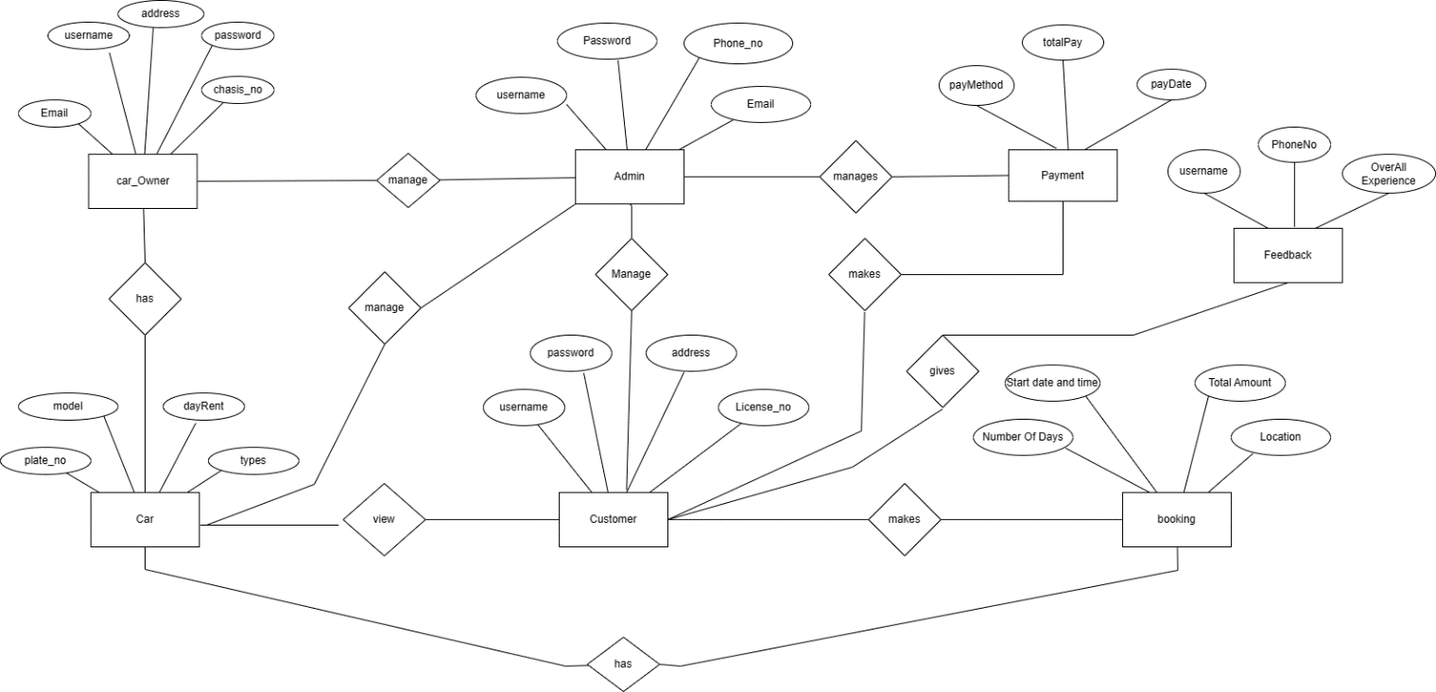
ANALYSIS AND DESIGN
ER Diagram

Slide 11
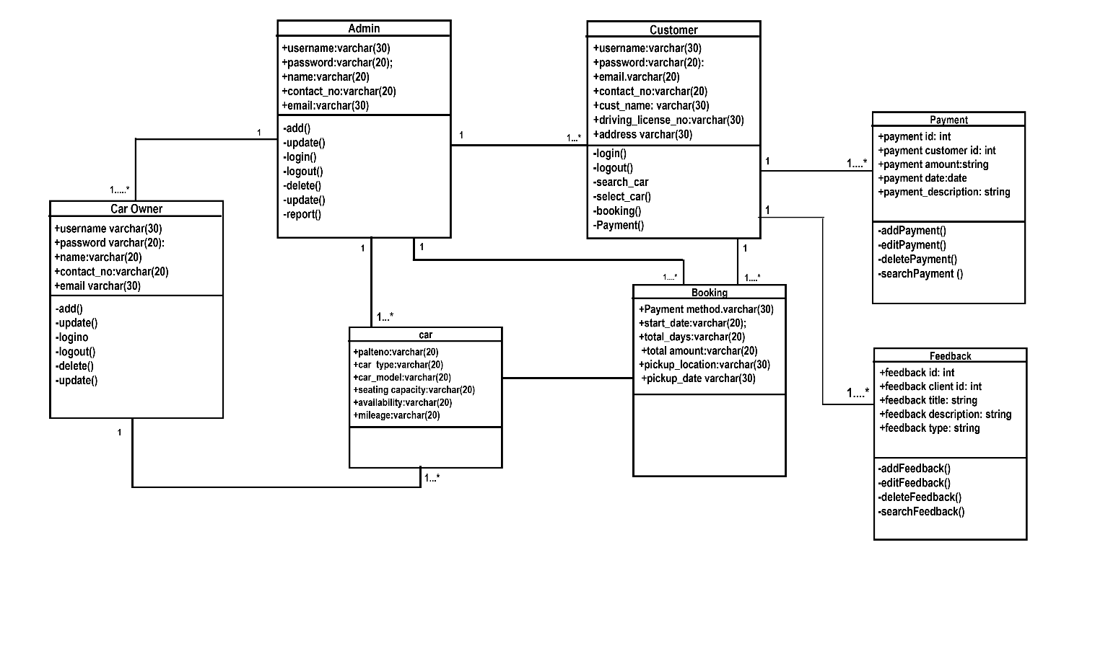
Class Diagram

Slide 12
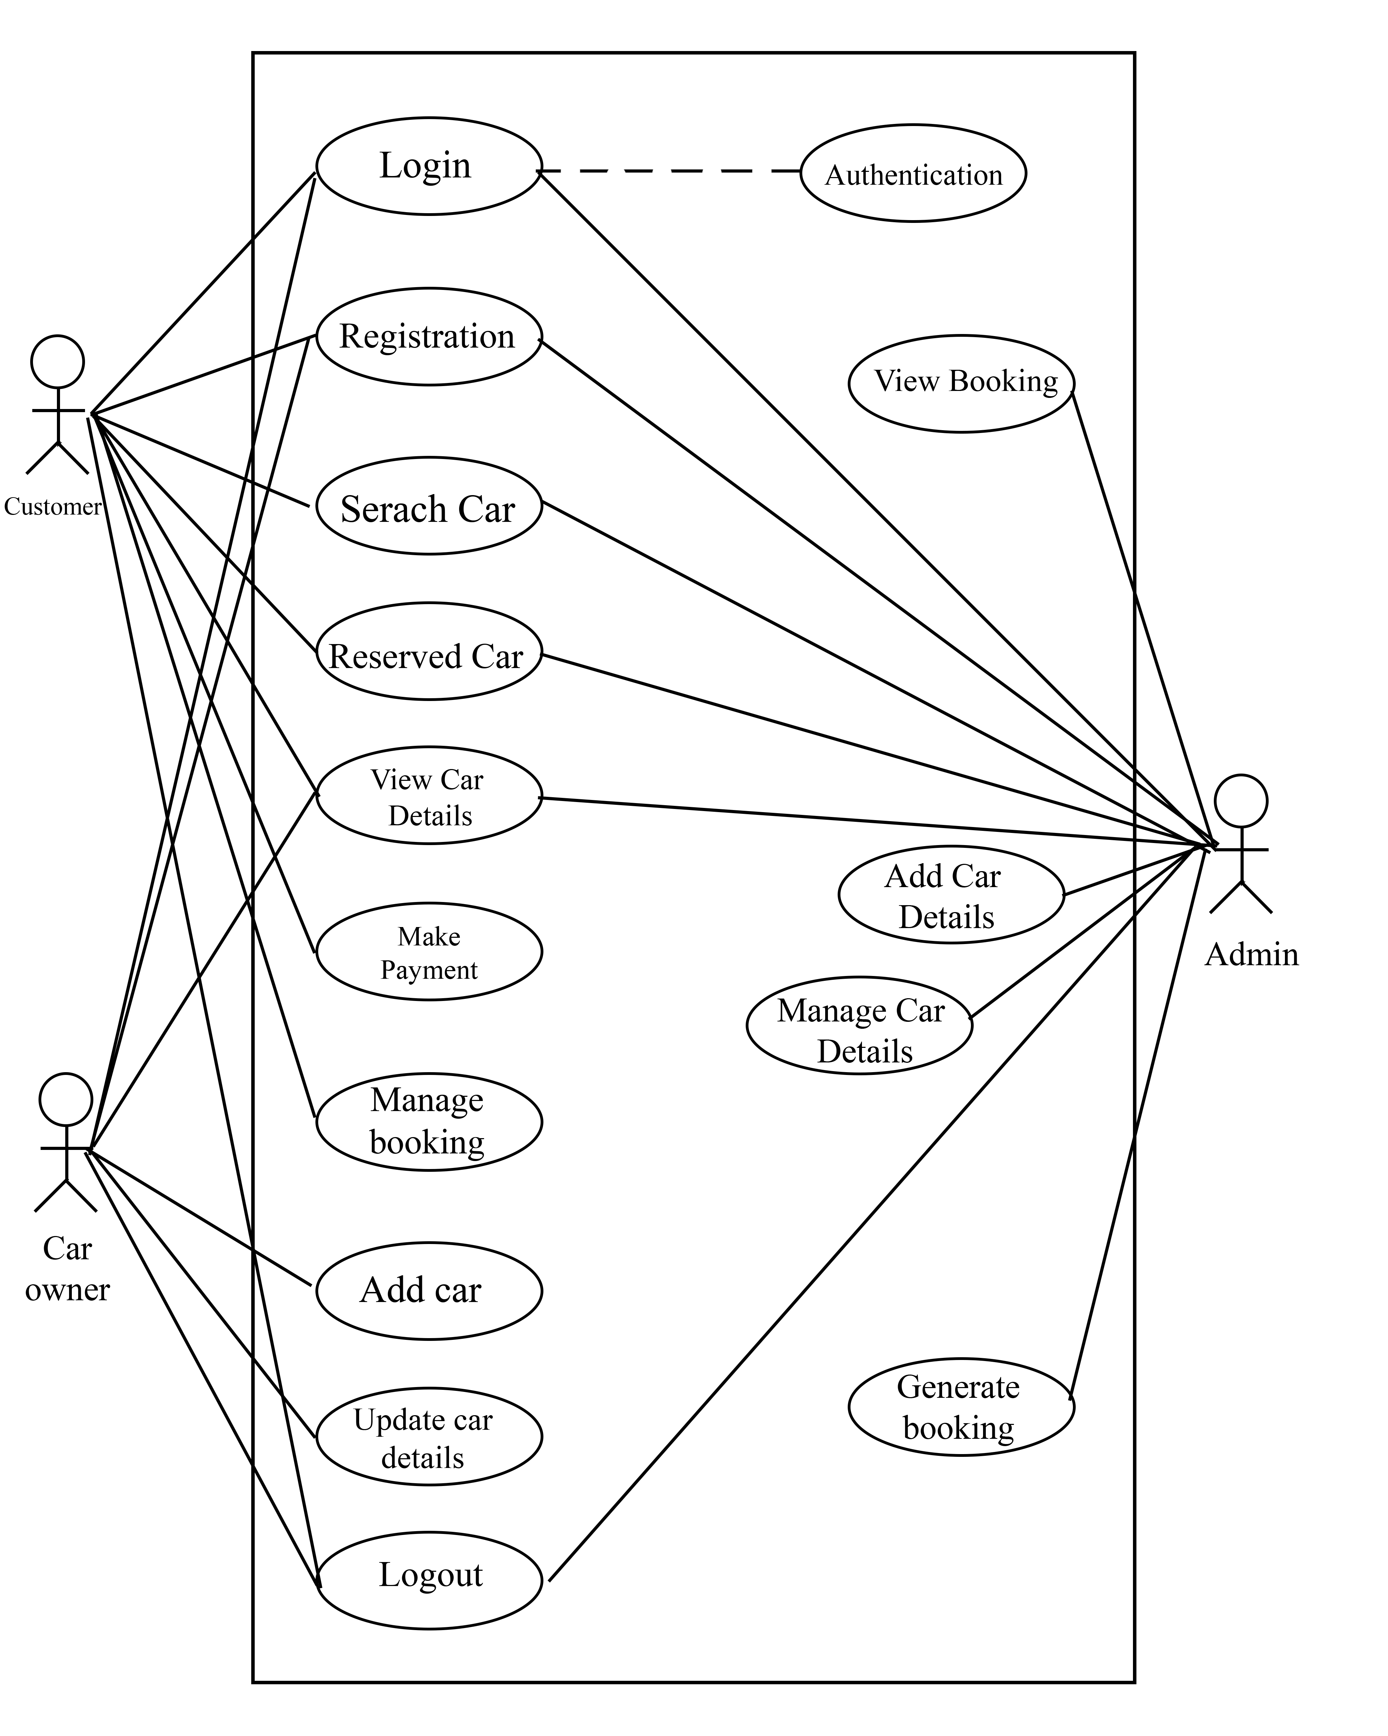
Use Case

Slide 13
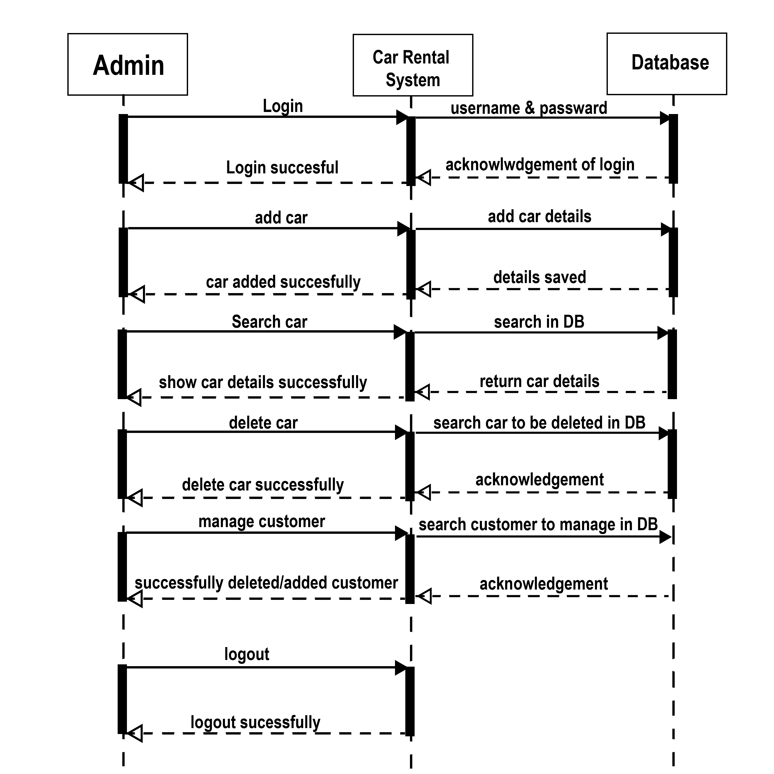
Sequence Diagram
Sequence Diagram for Admin

Slide 14
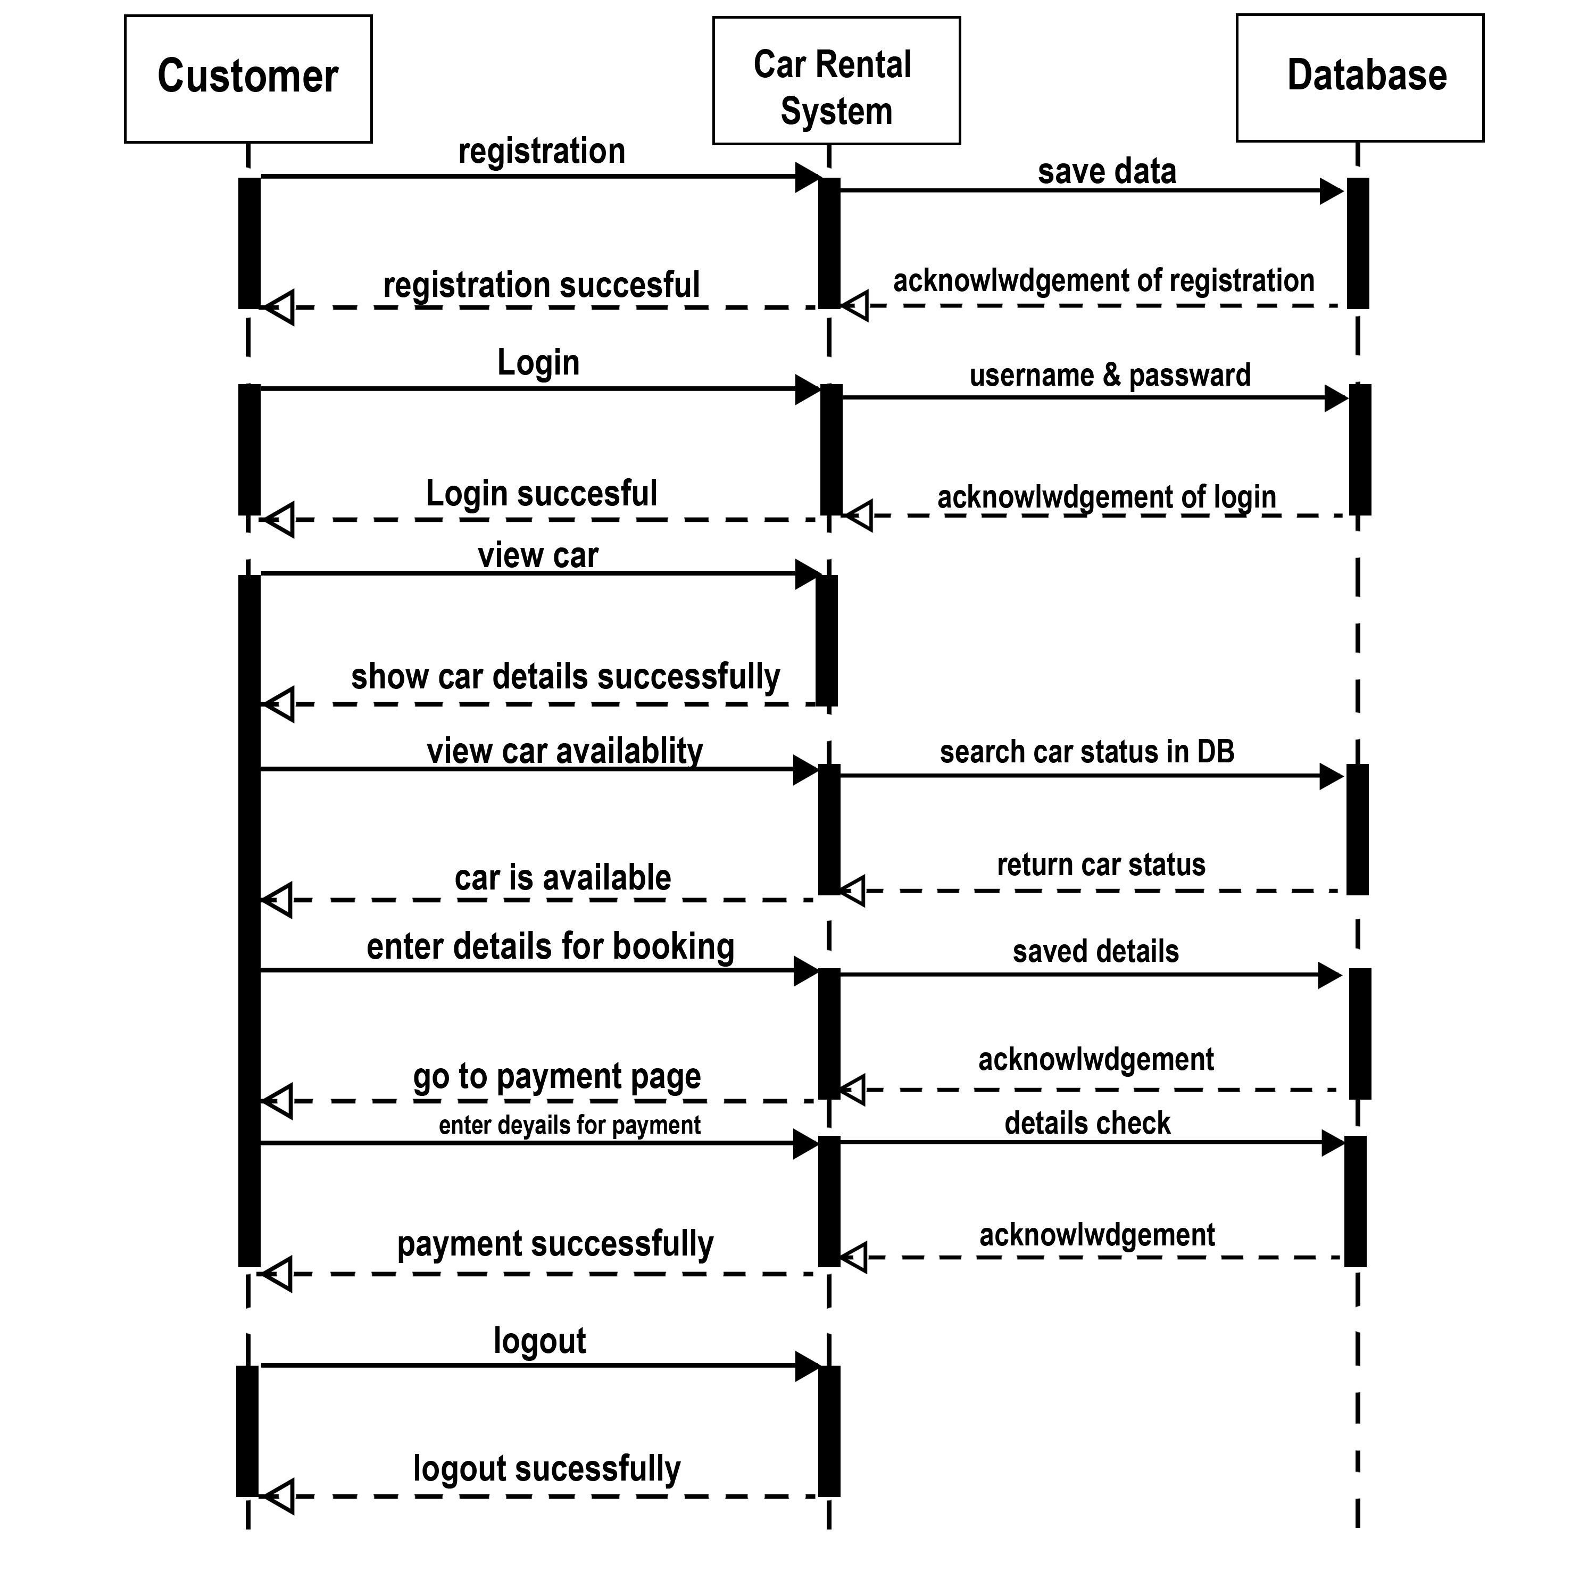
Sequence Diagram for Customer

Slide 15
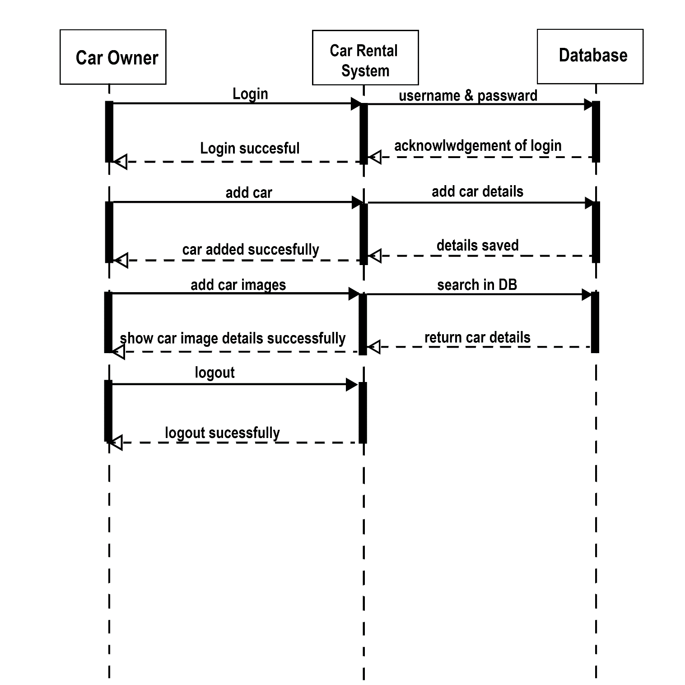
Sequence Diagram for owner

Slide 16
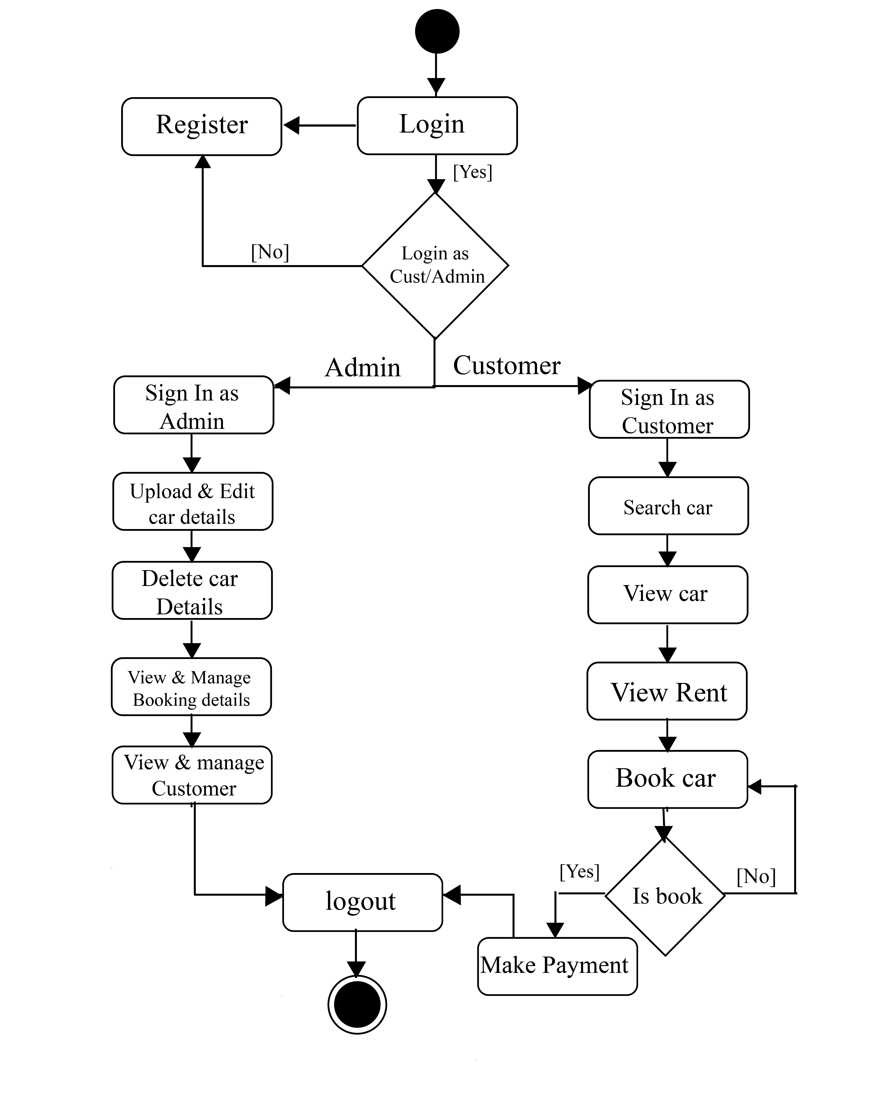
Activity Diagram
Activity Diagram for Admin and Customer

Slide 17
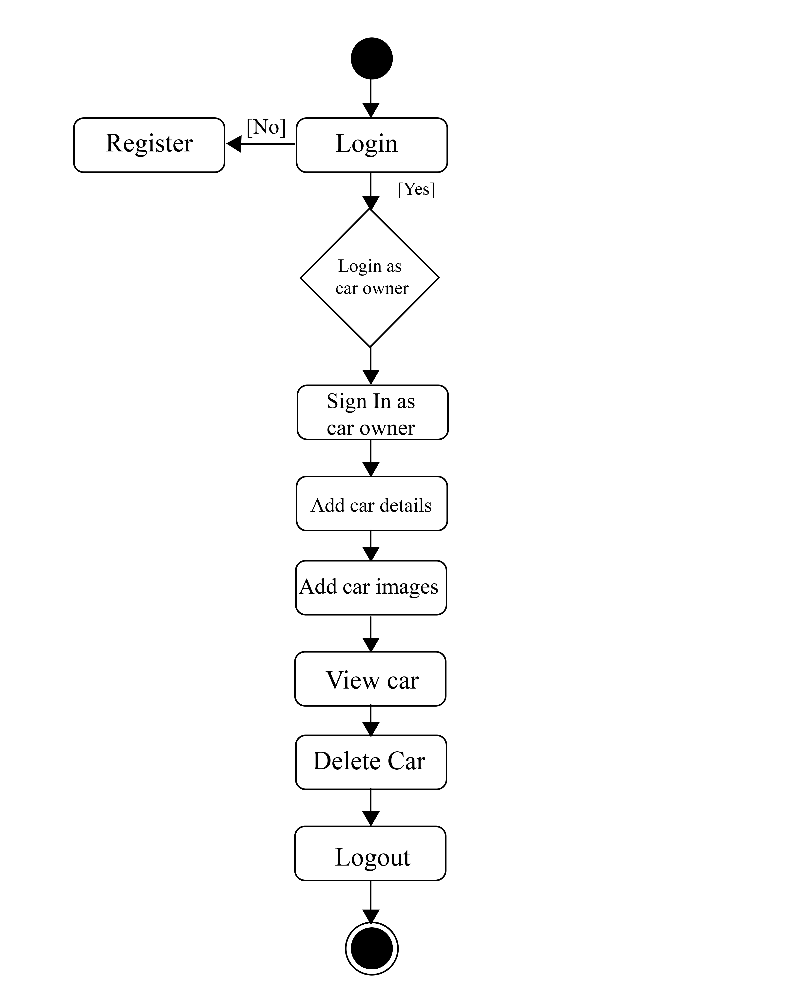
Activity Diagram for Car Owner

Slide 18
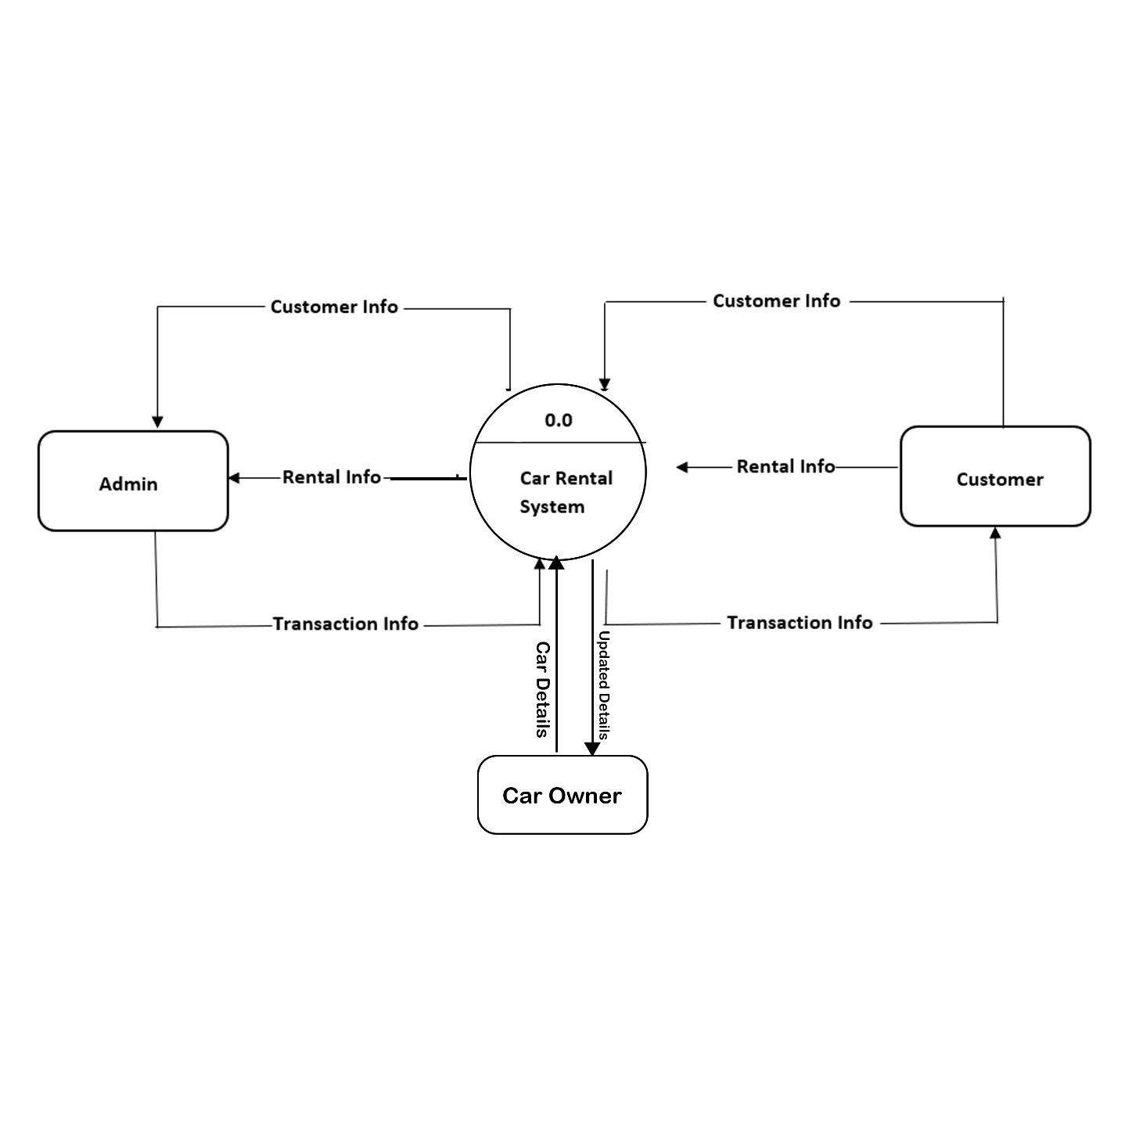
Data Flow Diagram
Level 0 :

Slide 19
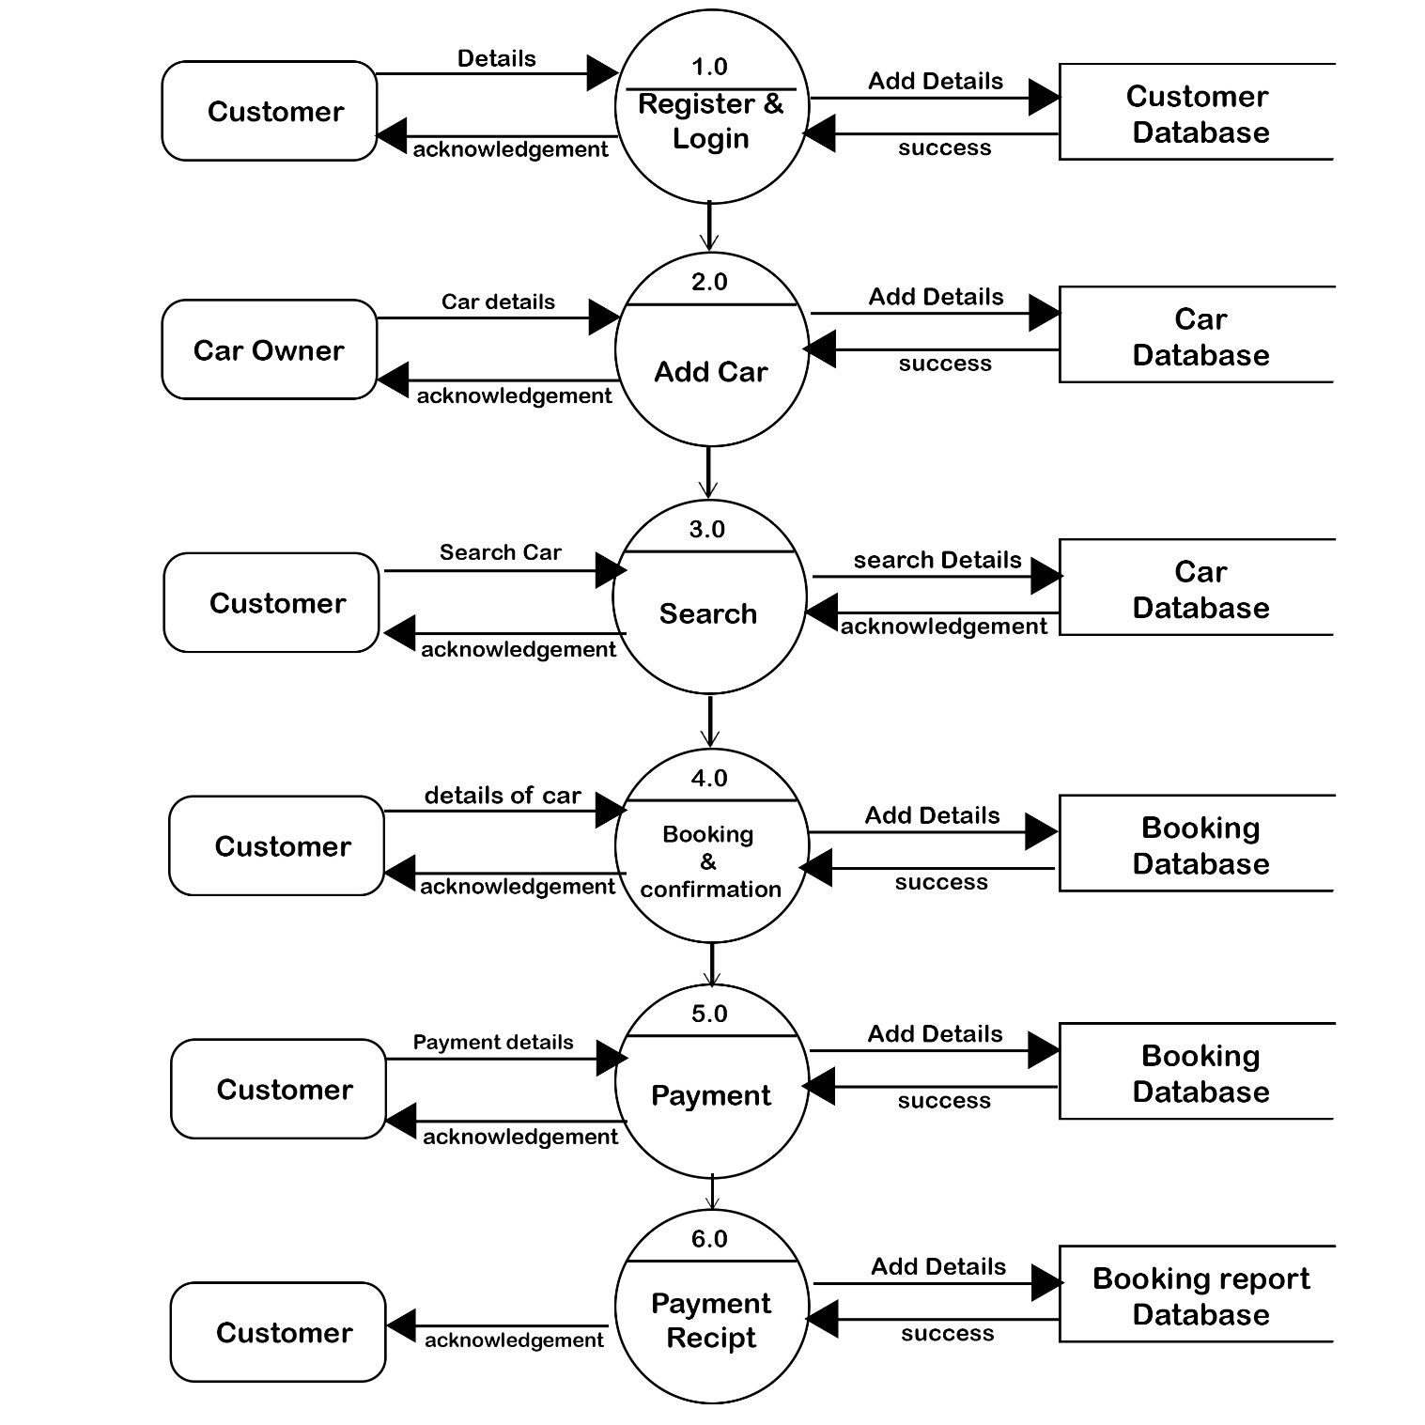
Level 1 :

Slide 20
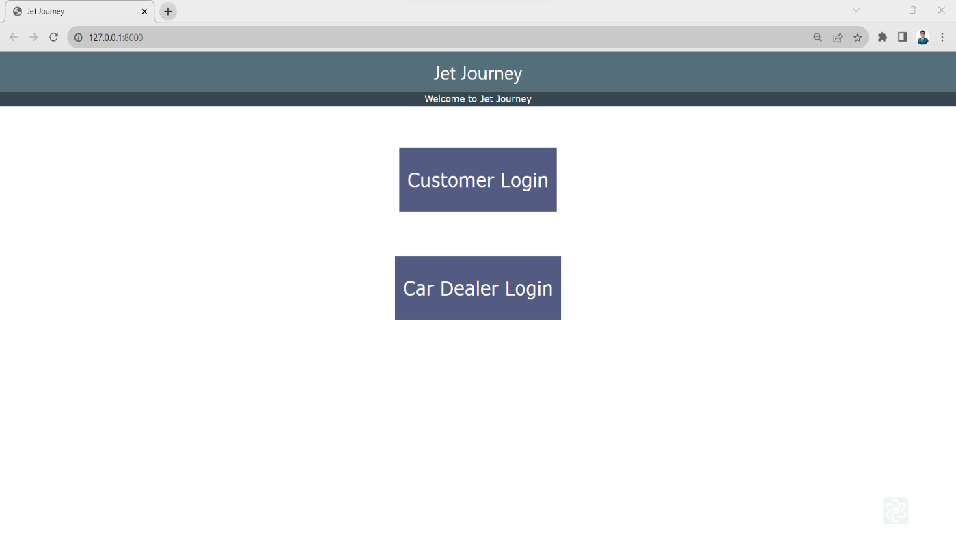
User Interface DESIGN
Home Page:

Slide 21
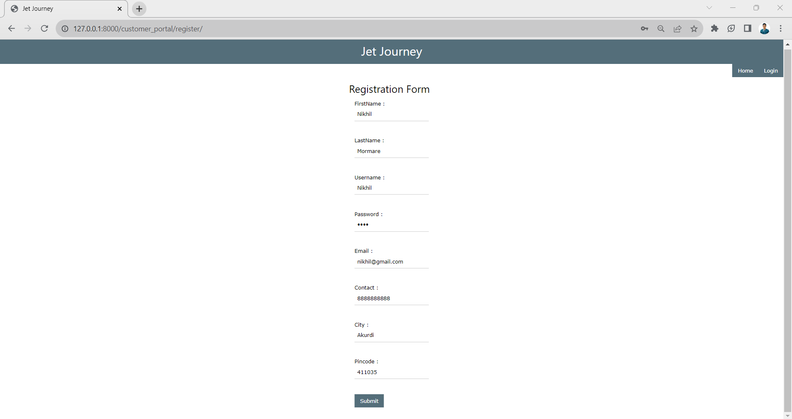
Customer Registration :

Slide 22
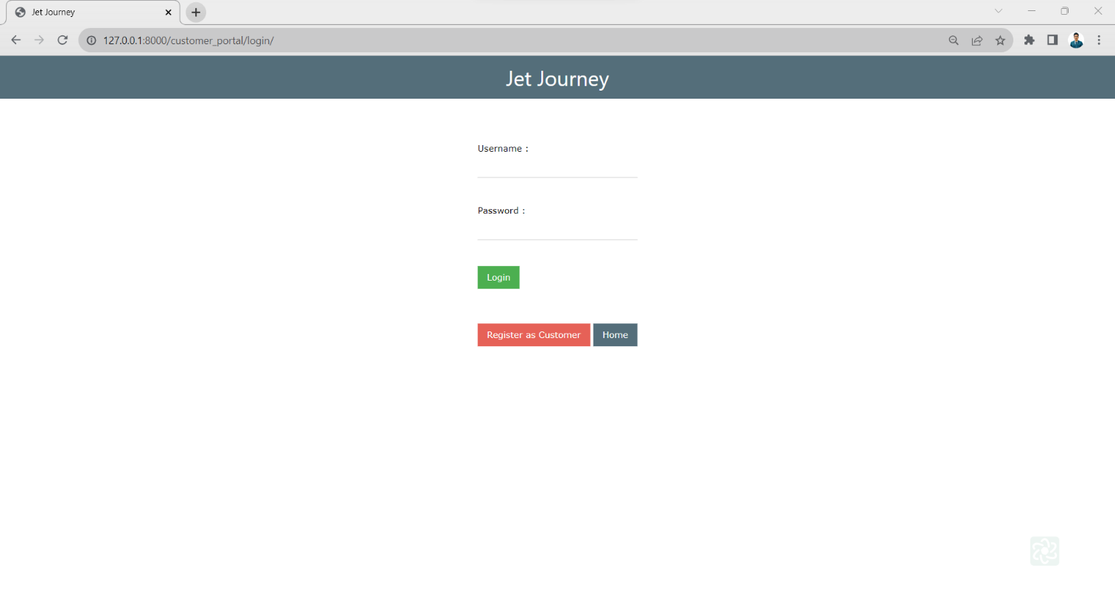
Customer login

Slide 23
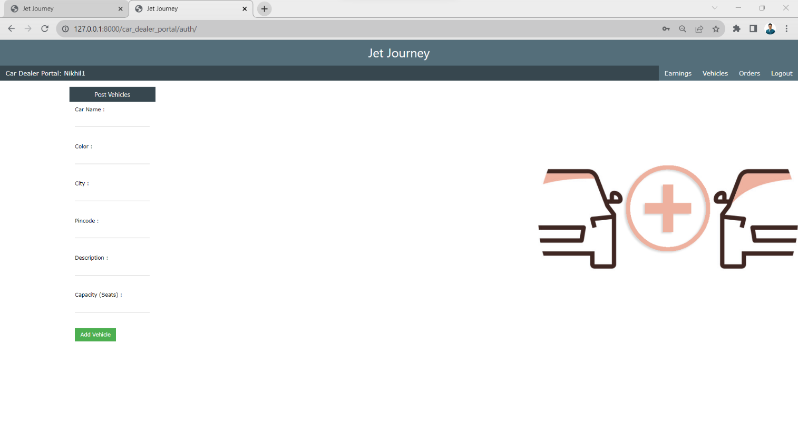
Add vehicles

Slide 24
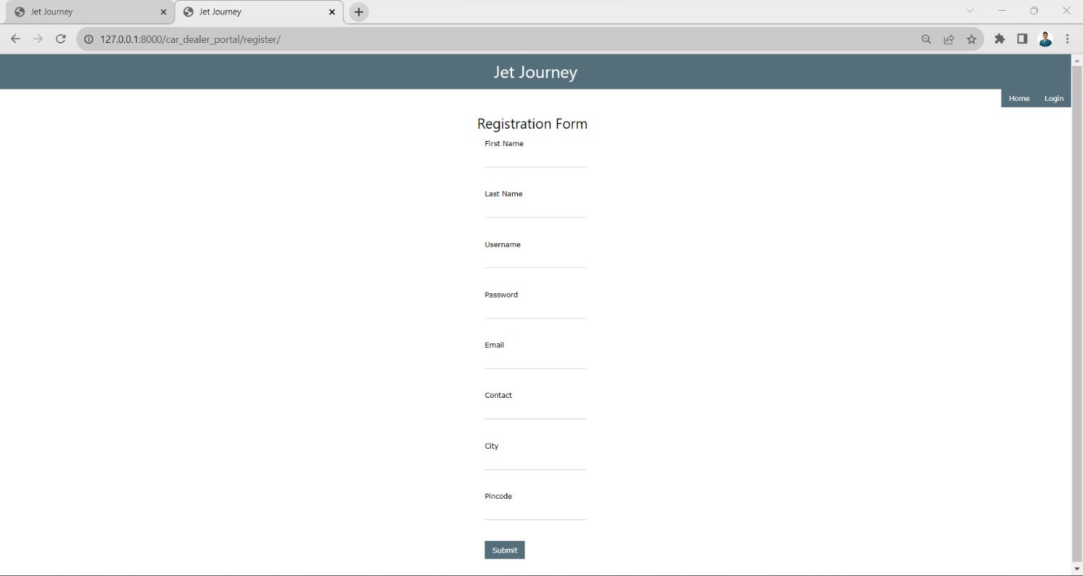
Car Dealer Registration:

Slide 25
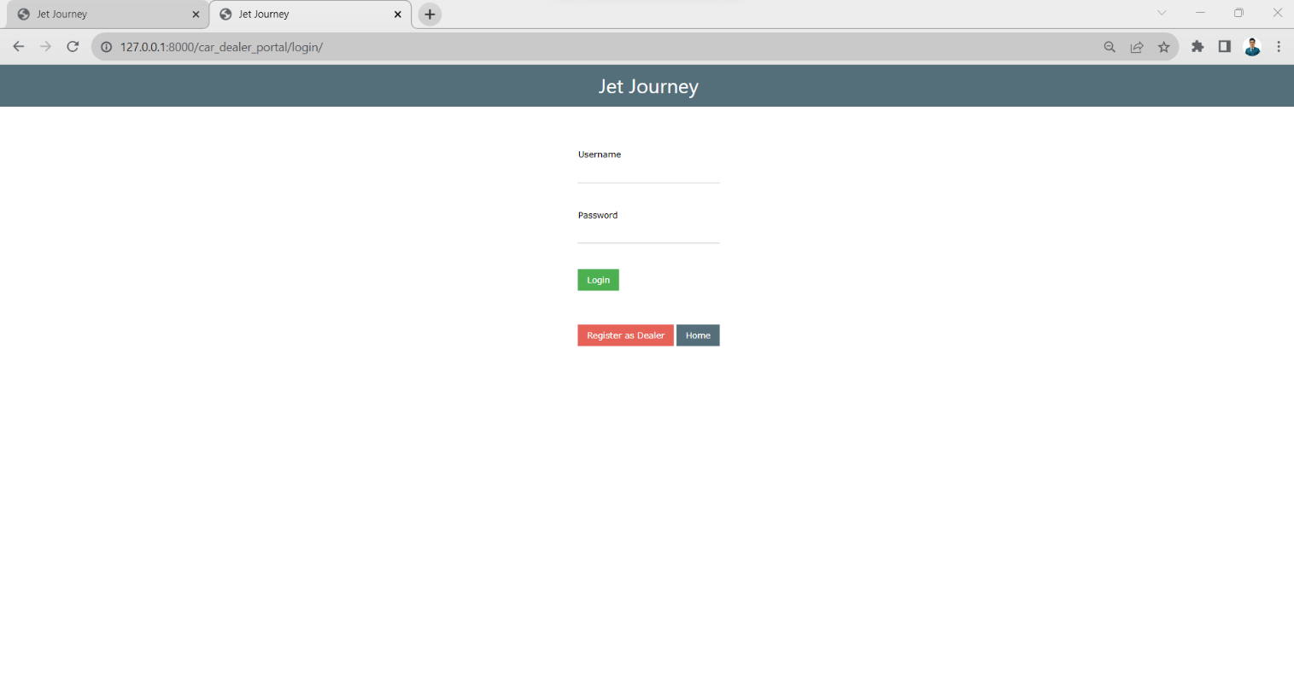
Car Dealer Login:

Slide 26
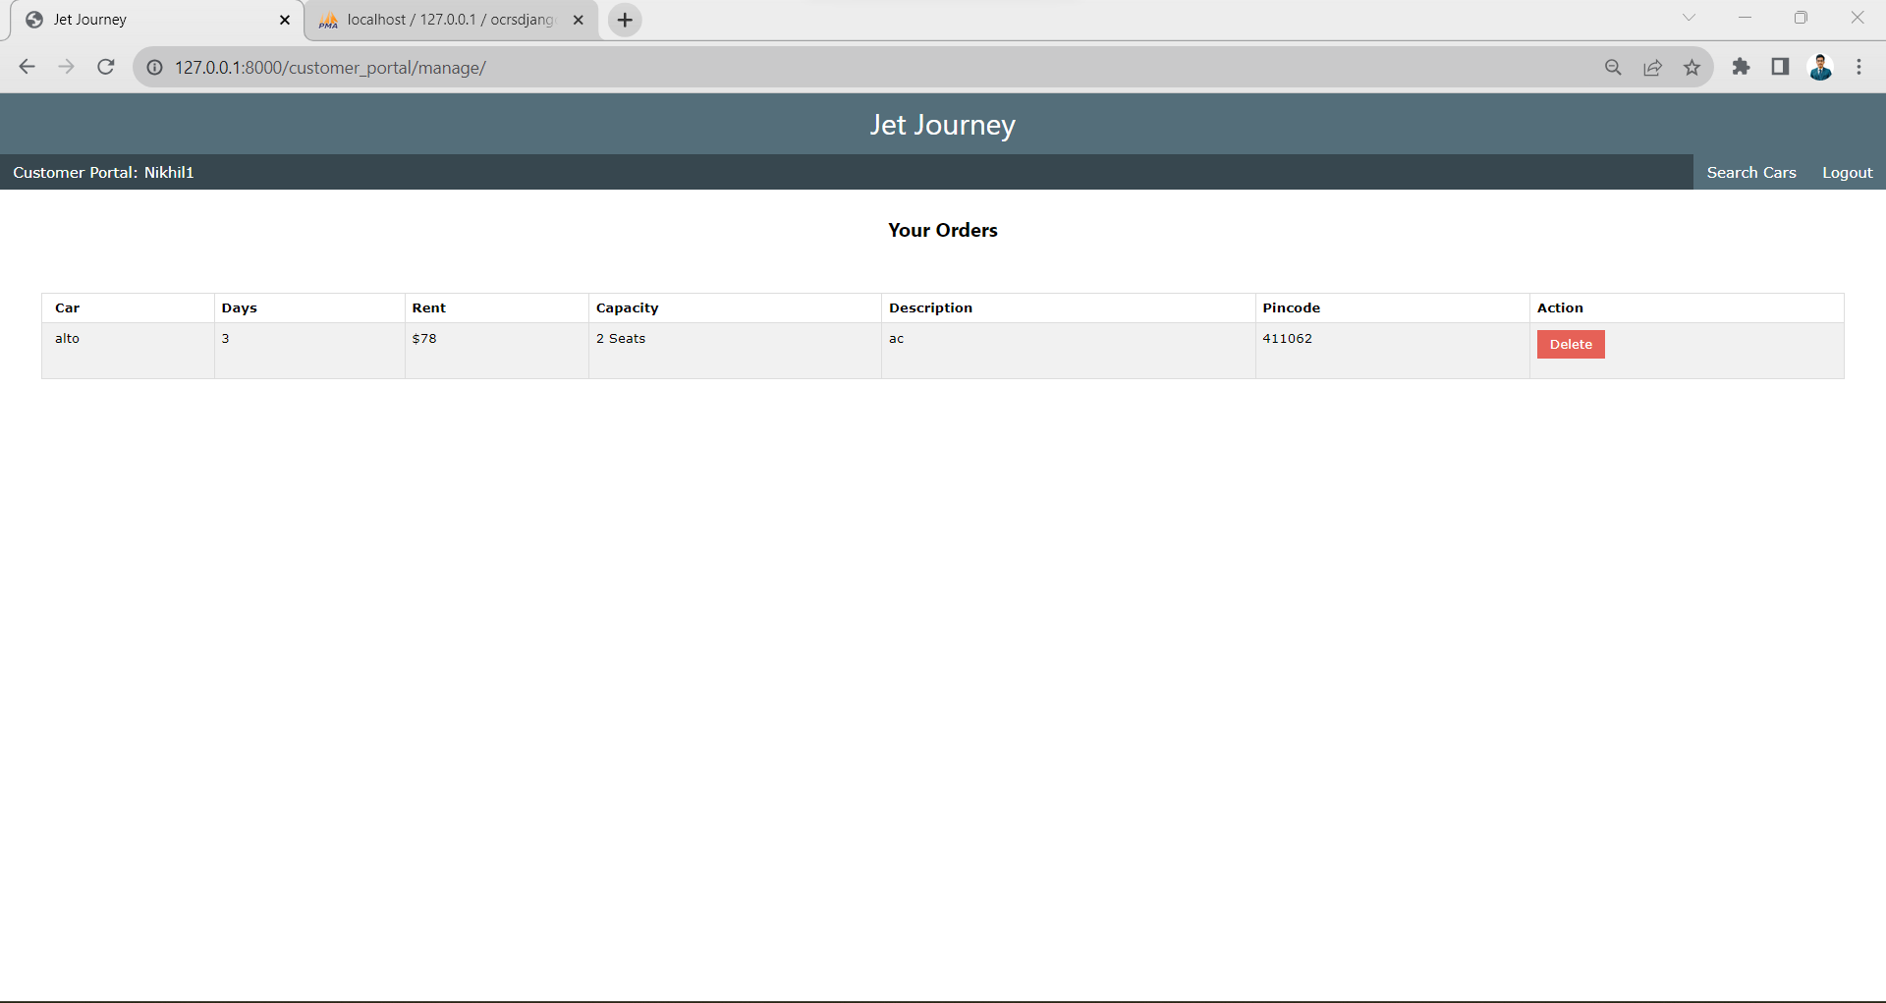
Manage Order

Slide 27
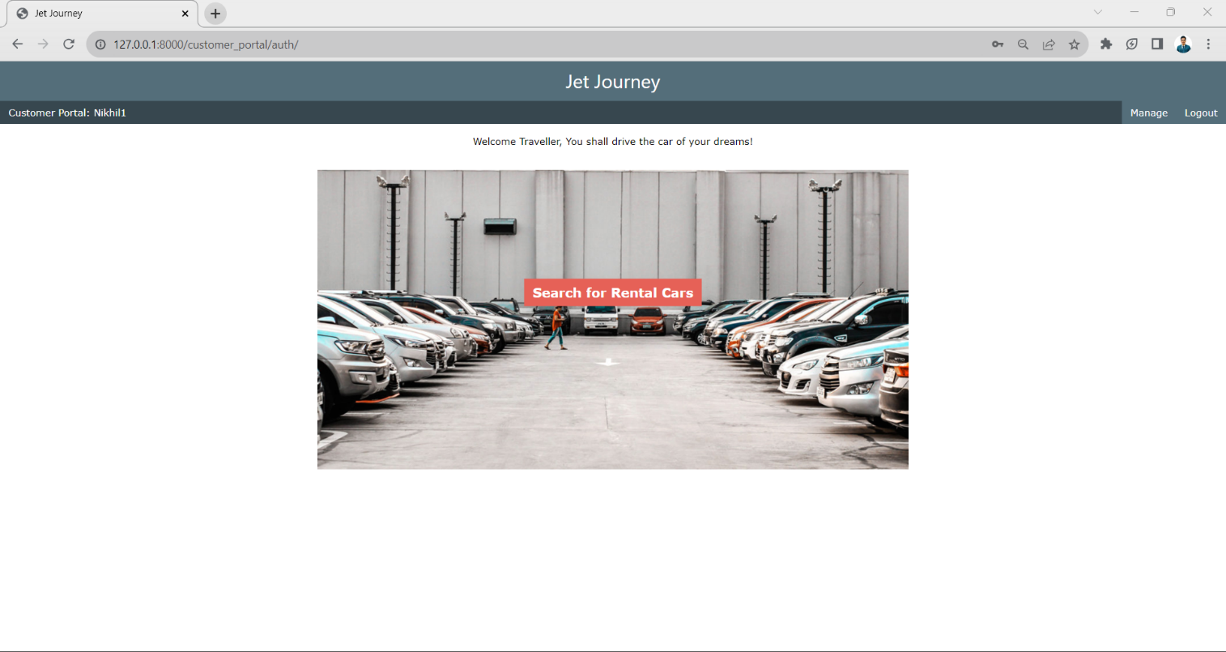
Customer Home Page

Slide 28
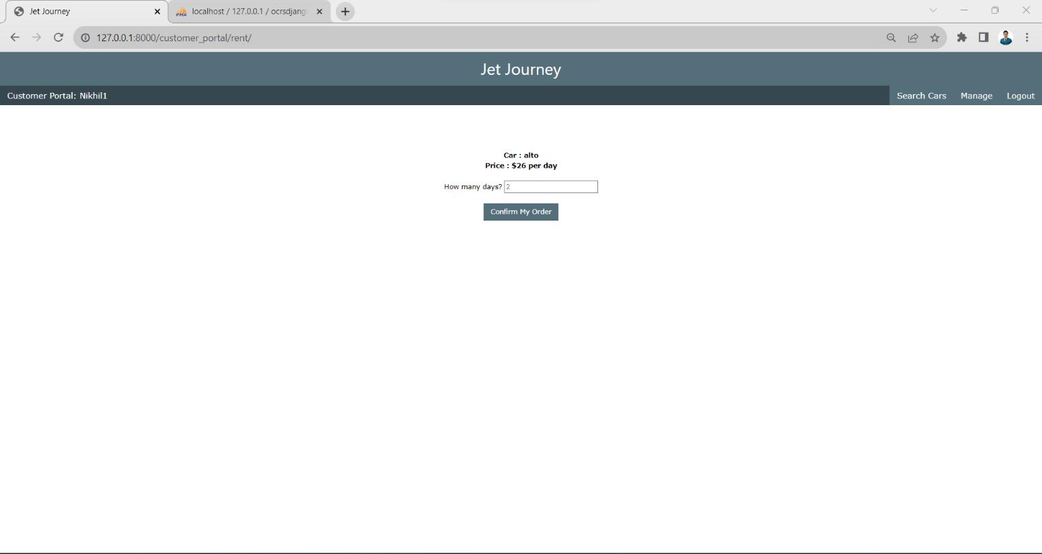
Booking

Slide 29
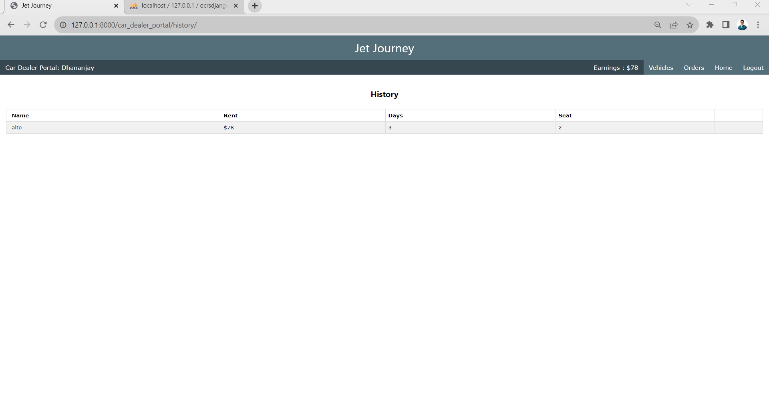
Total Earning

Slide 30
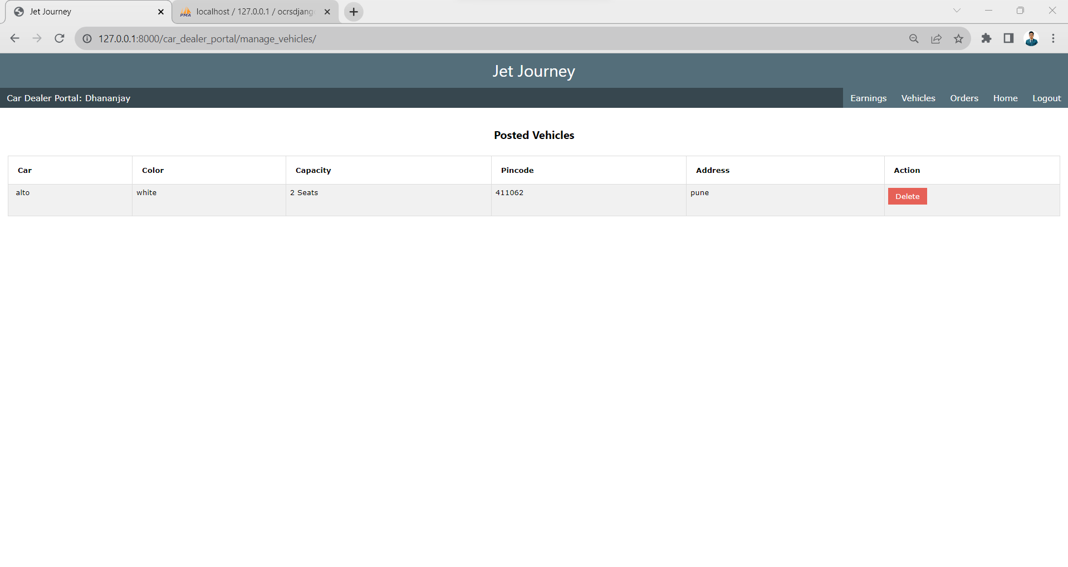
Posted Vehicle

Slide 31
Add Vehicle

Slide 32
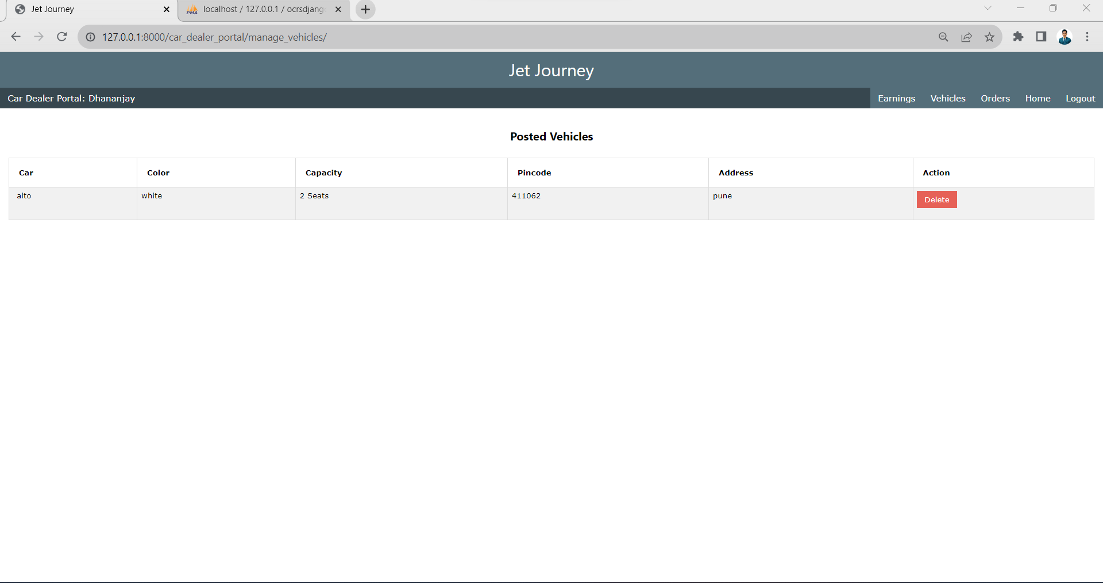
Manage Vehicle

Slide 33
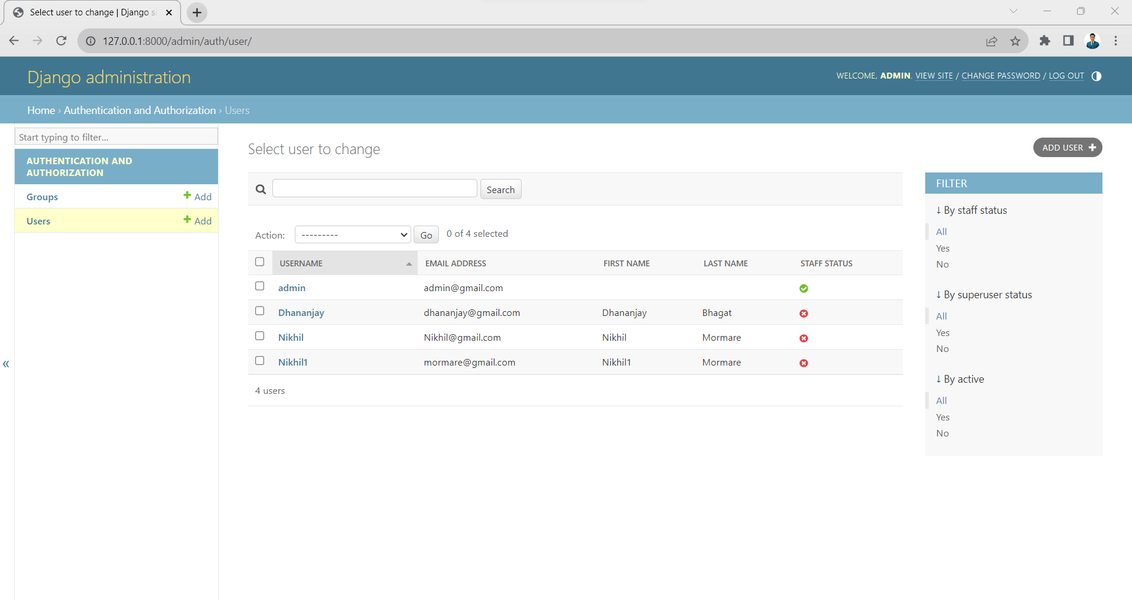
Admin Manage User

Slide 34
Data Dictionary
Admin Table
Sr. No | Field Name | Data Type | Size | Constraints | Description
1 | Username | Varchar | 20 | Primary key | Username
2 | Password | Varchar | 100 | Not Null | Password
3 | Admin Name | Varchar | 20 | Not Null | Admin Name
4 | Phone No | Int | 10 | Not Null | Phone No
5 | Email | Varchar | 20 | Not Null | Email
6 | City | Varchar | 20 | Not Null | City
7 | Pincode | Int | 20 | Not Null | Pincode

Slide 35
Customer
Sr. No | Field Name | Data Type | Size | Constraints | Description
1 | Username | Varchar | 20 | Primary key | Username
2 | Password | Varchar | 100 | Not Null | Password
3 | Customer Name | Varchar | 20 | Not Null | Customer Name
4 | Custid | Int | 10 | Not Null | Custid
5 | CustPhone No | Int | 10 | Not Null | CustPhone No
6 | CustEmail | Varchar | 20 | Not Null | CustEmail
7 | CustCity | Varchar | 20 | Not Null | CustCity
8 | Pincode | Int | 20 | Not Null | Pincode
9 | Admin Name | Varchar | 20 | Foreign Key | Admin Name
10 | Payment id | int | 20 | Foreign Key | Payment id

Slide 36
Sr. No | Field Name | Data Type | Size | Constraints | Description
1 | Username | Varchar | 20 | Primary key | Username
2 | Password | Varchar | 100 | Not Null | Password
3 | Dealer Name | Varchar | 20 | Not Null | Dealer Name
4 | Dealer Phone No | Int | 10 | Not Null | Dealer Phone No
5 | Dealer Email | Varchar | 20 | Not Null | Dealer Email
6 | Dealer City | Varchar | 20 | Not Null | Dealer City
7 | Pincode | Int | 20 | Not Null | Pincode
8 | Admin Name | Varchar | 20 | Foreign Key | Admin Name
Car Dealer

Slide 37
Sr. No | Field Name | Data Type | Size | Constraints | Description
1 | PlateNo | Varchar | 20 | Primary key | PlateNo
2 | Username | Varchar | 100 | Not Null | Username
3 | PayMethod | Varchar | 20 | Not Null | PayMethod
4 | StartDate | Int | 10 | Not Null | StartDate
5 | TotalDays | Varchar | 20 | Not Null | TotalDays
6 | TotalAmt | Varchar | 20 | Not Null | TotalAmt
7 | PickLocation | Int | 20 | Not Null | PickLocation
8 | Admin Name | Varchar | 20 | Foreign Key | Admin Name
9 | Custid | Int | 10 | Foreign Key | Custid
10 | PlateNo | varchar | 20 | Foreign Key | PlateNo
Booking
Car
Sr. No | Field Name | Data Type | Size | Constraints | Description
1 | PlateNo | varchar | 20 | Primary key | PlateNo
2 | CarType | varchar | 100 | Not Null | CarType
3 | Model | varchar | 20 | Not Null | Model
4 | Colour | varchar | 20 | Not Null | Colour
5 | TotalSeats | int | 10 | Not Null | TotalSeats
6 | IsAvailable | varchar | 50 | Not Null | IsAvailable
7 | Mileage | int | 15 | Not Null | Mileage
8 | Dealer Name | Varchar | 20 | Foreign Key | Dealer Name
9 | Admin Name | Varchar | 20 | Foreign Key | Admin Name

Slide 38
Booking Report
Sr. No | Field Name | Data Type | Size | Constraints | Description
1 | Payment id | int | 20 | Primary key | Payment id
2 | PlateNo | varchar | 20 | Not Null | PlateNo
3 | Username | varchar | 100 | Not Null | Username
4 | Paymethod | varchar | 20 | Not Null | Paymethod
5 | Startdate | varchar | 20 | Not Null | Startdate
6 | Totaldays | int | 10 | Not Null | Totaldays
7 | Totalamt | int | 50 | Not Null | Totalamt
8 | Picklocation | varchar | 15 | Not Null | Picklocation
9 | Custid | Int | 10 | Foreign Key | Custid

Slide 39
Drawbacks And Limitations
Dependency on Internet Connectivity: The system's reliance on internet connectivity may pose challenges for users in areas with limited or no access.
Security Concerns: Despite user authentication, security vulnerabilities may still exist, necessitating constant monitoring and updates.
Initial Development Costs: The high initial development costs may be a limitation for smaller rental businesses with budget constraints.
Scalability Challenges: Adapting to sudden spikes in user traffic may pose scalability challenges, impacting system performance.

Slide 40
Proposed Enhancement
Offline Functionality Improvement: Enhance offline functionality to ensure a seamless user experience, especially in areas with limited internet connectivity.
Advanced Security Measures: Implement advanced security measures, including encryption and regular security audits, to fortify the system against potential vulnerabilities.
Cost-Effective Development Strategies: Explore and adopt cost-effective development strategies, such as leveraging open-source tools, to reduce initial development costs and increase accessibility for smaller businesses.
Scalability Optimization: Optimize system scalability through load balancing and server enhancements to efficiently handle increased user traffic.
User Onboarding Simplification: Simplify user onboarding processes and provide user-friendly tutorials to minimize the learning curve for new users.

Slide 41


